Slide 1

PANIMALAR ENGINEERING COLLEGE
(An Autonomous Institution) Bangalore Trunk Road,Varadharajapuram
Poonamallee,Chennai-600 123
DEPARTMENT OF COMPUTER SCIENCE AND ENGINEERING
TITLE: Real-Time Road Lane Line Detection for Advanced DrivingAssistance
DOMAIN : MACHINE LEARNING
TEAM NO : E27
Team Members:
211420104049-Chintham Reddy Lalithaditya
GUIDED BY
Mrs.Sophana Jenniffer
Department of Computer Science and Engineering

Slide 2
OVERVIEW
Objective
Abstract
Literature Survey
Existing System
Limitations of Existing System
Proposed System
Advantages of Proposed System
Architecture Diagram
System Required Specifications
List of Modules

Slide 3
OBJECTIVE
The major objective of the proposed work is to extract frames from a video and apply image processing techniques to detect the lanes. Join all the lanes and form two lines at the boundaries of the path. Plot the path between the lanes. Predict the turn-based on the length of the boundary lines. Display the turnover of the image.

Slide 4
ABSTRACT
Many technical improvements have recently been made in the field of road safety, as accidents have been increasing at an alarming rate, and one of the major causes of such accidents is a driver's lack of attention. To lower the incidence of accidents and keep safe, technological breakthroughs should be made. One method is to use Lane Detection Systems, which function by recognizing lane borders on the road and alerting the driver if he switches to an incorrect lane marking.

Slide 5
LITERATURE SURVEY
TITLE OF THE PAPER | AUTHOR | VOLUME NUMBER | LANGUAGE | YEAR OF PUBLICATION
A lane detection approach based on intelligent vision | Shu-Chung Yi , Yeong- chin chen , Ching-Haur Chang | 28 . 7 | Java | 2015
An effective lane line detection method based on computer vision | HG Zhu | 286 | Python | 2021
Advanced lane detection technique for structural hihway based on computer vision algorithm | K.Dinakaran , A.Stephen Sagayaraj , S.K. kabilesh , T.Mani , A.Anand kumar | 185 | Python | 2020

Slide 6
EXISTING SYSTEM
At present, these kinds of lane marking line detection methods based on machine vision and can be divided into two categories:
. The traditional image processing method and
. Semantic segmentation (includes deep learning) methods.

Slide 7
LIMITATIONS OF EXISTING SYSTEM
All the existing cars does not have ADAS (Advanced Driver Assistance
System)
When affected by other markers on the driveway, or when the lane is damaged or the pollution is serious, the image of the lane line collected by the system is incomplete and of poor quality, making it difficult for the system to accurately judge and analyze the data
Lane detection in complex road conditions is susceptible to external environmental factors, such as lack of light, road tortuosity and vehicle obstruction.
While existing lane recognition algorithms demonstrated over 90% detection rate, the validation test was usually conducted on limited scenarios.

Slide 8
PROPOSED SYSTEM
The line drawing function “Draw_Lines()” is
implemented to connect the line segments for each lane-line (left or right) to produce one solid line that tracks the actual lane- line in the images.
The line segments are produced by Hough transform as shown by and the “Draw_Lines()” function is connecting them to be like the ones

Slide 9
ADVANTAGES OF PROPOSED SYSTEM
Original color image
Gray scale
Gaussian blur reduction
Canny edges
Overlay hough image on original

Slide 10

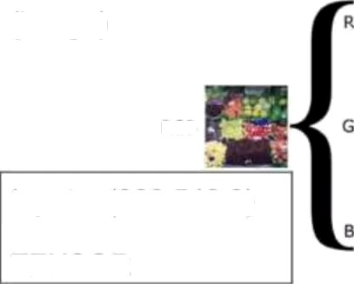






1. ray Scale
We convert our image to Gray scale so that we can abstract away from a Tensor to a Matrix and deal with raw pixel values. (960,540,3)-» (960,540)
Treat yellow or white lane lines the same
Pixel list = colour channel
Average colour channel values within pixel list (R+G+B/3)
gray cv2.grayscale(image)
Re0
output = 960 540
MATRIX
RGB
Green
Input = (960,540,3)
Blue
TENSOR

Slide 11

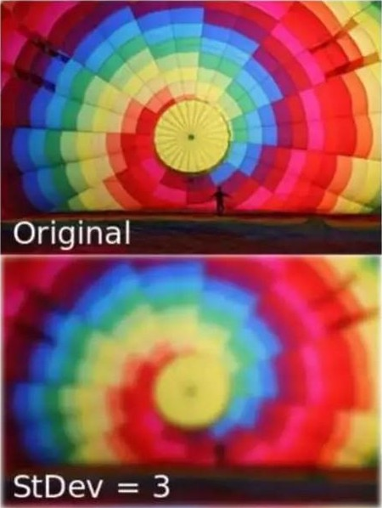
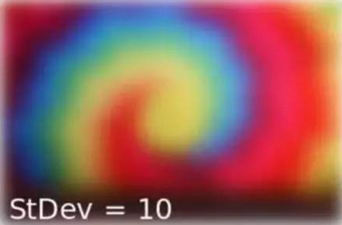
2. Gaussian ur
Apply Gaussian Blur to reduce image noise and
details.
Smooth out the image before applying Canny
edge detection so we do not detect faint edges
Blur gray= cv2.GaussianBIur(src,ksize,std_dev)
Src: image to modify
Ksize = kernel size. Larger kernel size implies averaging/ smoothing over a larger area. (Sample size for convolution)

Slide 12
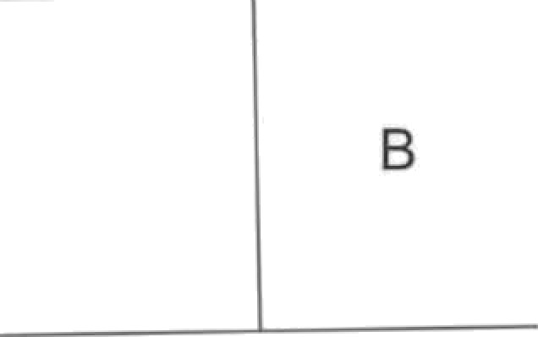
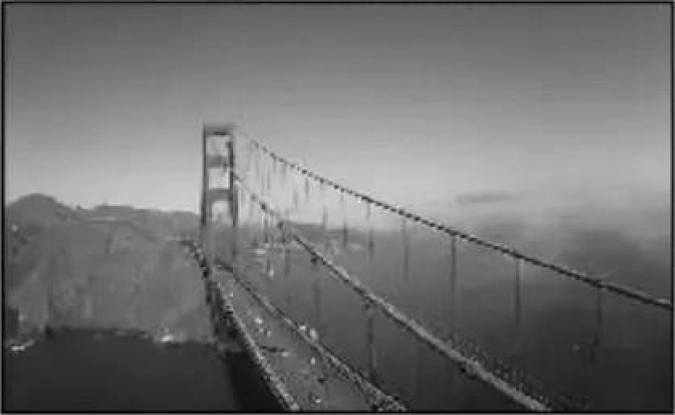
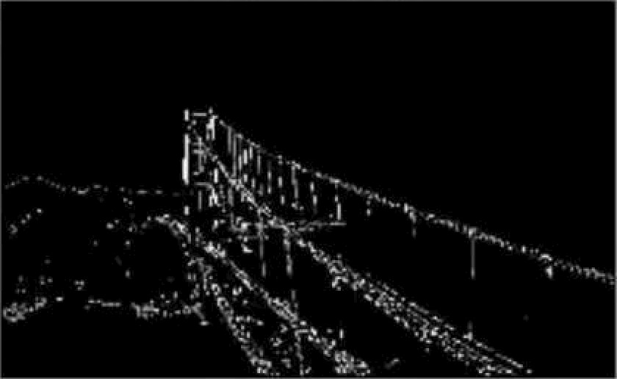
3. Canny Edge Detection
Used to detect boundaries of an image
Uses differential of pixel values
Three regions:
Pixel higher than upper threshold = edge (kept)
Pixel between high and low is accepted if connected to edge
Pixel below low rejected
Recommend 1:2 or 1:3 low: high threshold ratio
A
High Threshold
Original Image
Edge Image
“,‘*””””””"””w
Low Threshold

Slide 13

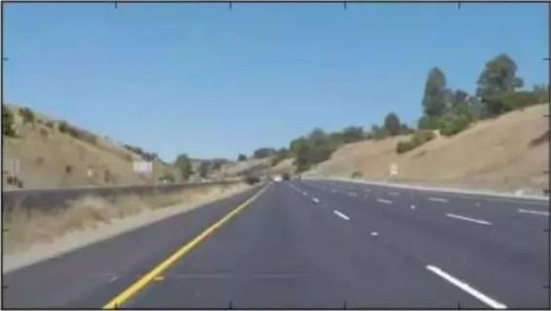
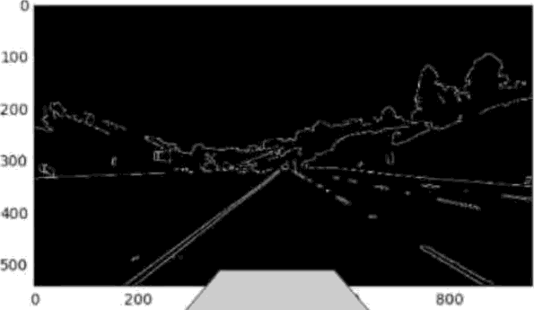
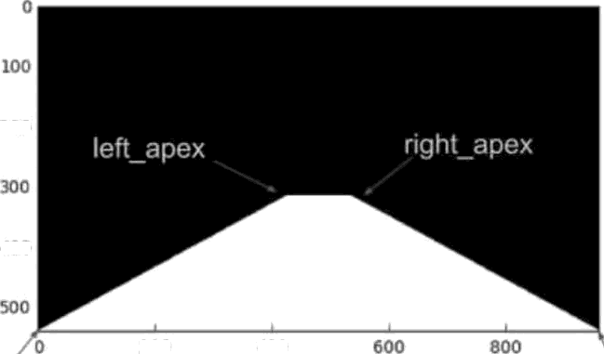
Masked Image
We want to narrow down our analysis to a section of the image
Apply a trapezoidal mask over edges
Use bitwise AND to return image only where mask pixels are non- zero.
300
't0 0
TOO
0
20U
4U0
t00
800
000
400
Apply over edges
200
-l0G
Ieñ_boflom
X
right_bottom

Slide 14

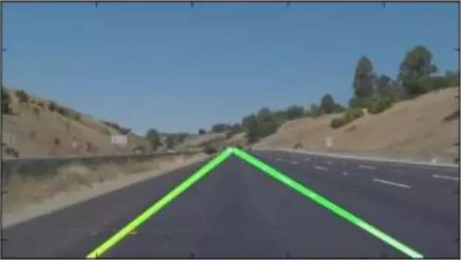
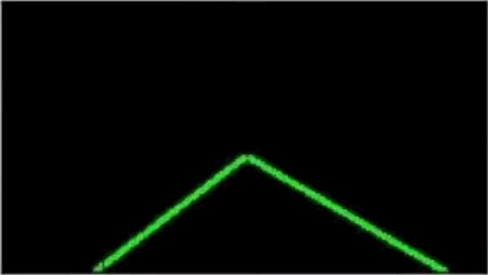

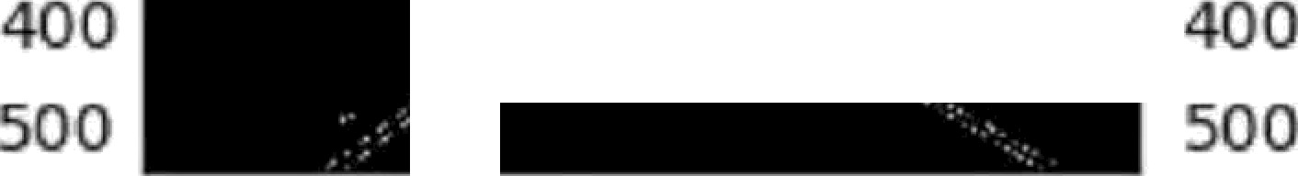


5. Hough Transform
Goal: To identify straight lines
Process: For each pixel at (x,y) the hough transform algorithm determines if there is
enough evidence of a straight line at that pixel
Line= cv2.HoughLinesP(canny_edges,rho,theta,threshold,min_Iine_length,max_Iine_gap)
Rho: Distance of P(pixels). Minimum value of 1. higher Rho= Increased distance resolution
Theta: angular resolution. Higher theta = higher angular resolution
Min„line_length: minimum length of a line in pixels you will accept in the output
Max_line_gap: max distance (in pixels) between segments that you allow to connected
into a single line
Hough imaqe
0
0
100
200
300
0
oo
200
300
40 0
X0
0 200 400 600 800
0 200 400 000 800
0
20J
t0O
000
800

Slide 15

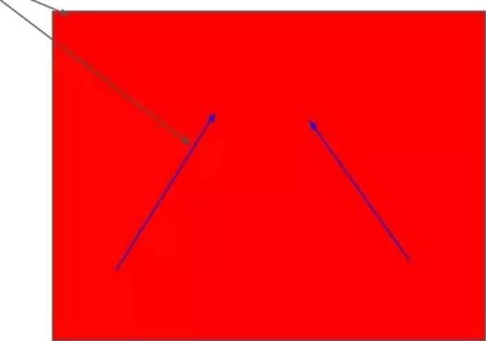
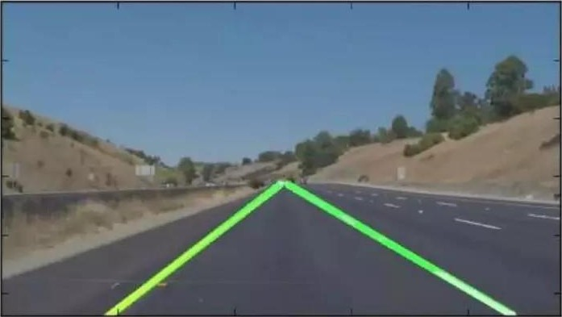
Overlay Hough Image on Original
Cv2.addWeighted(initiaI_img, a, img, §, 1)
InitiaI_img: original img to write over
Img: img to overlay on tp of initiaI_img
0
100
200
300
400
TOO | 0 | 700 | 400 | 600 | 800

Slide 16
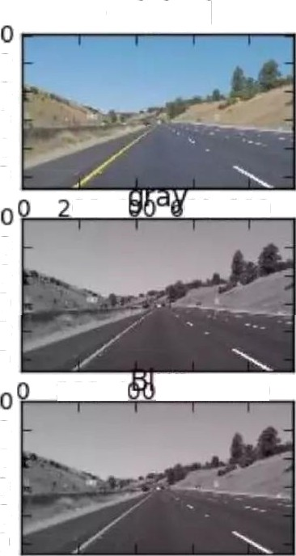
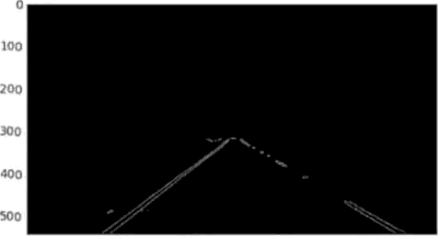
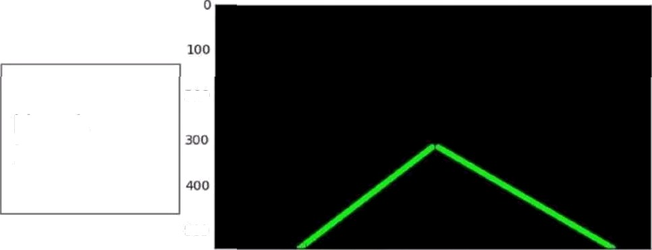


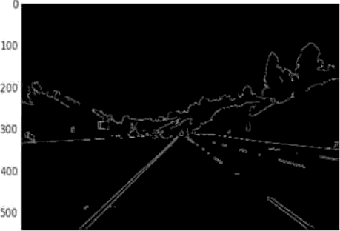



A
Original Color Image (960,540,3)
Original
Masked
Image
LOO
200
300
400
500
Grayscale (960,540)
100
200
300
400
500
200
Hough Image
200 4 TOO 800
100
200
300
400
500
Gaussian Blur
500
0
200
400
600
800
0 200 400 600 800
Canny Edges
100
?O0
30 0
40U
0
200
400
60 0
800

Slide 17
HARDWARE AND SOFTWARE SPECIFICATION
Software requirements
TensorFlow (Machine learing frameworks) | Python
Open CV | Canny edge detector
Hardware requirements
Laptop with windows 7 (min) , Camera

Slide 18
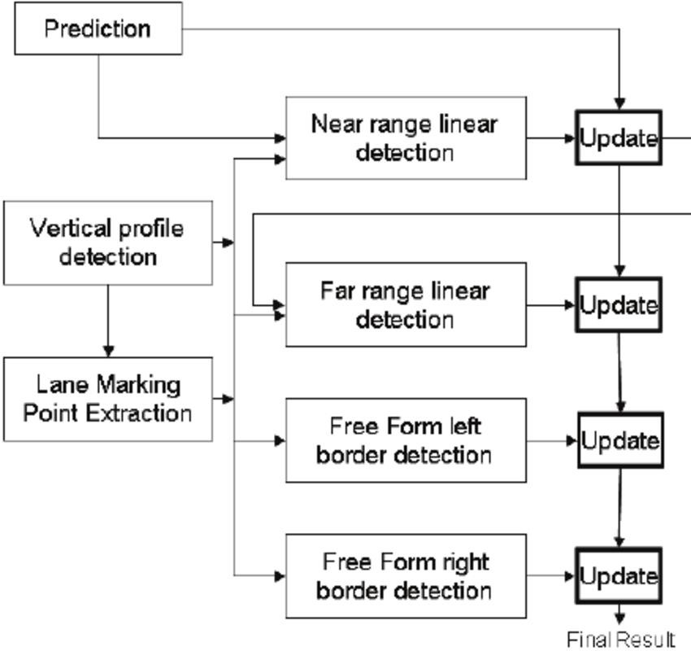
ARCHITECTURE DIAGRAM

Slide 19
MODULES
1. Image Acquisition:
Responsible for capturing images or video frames ensures a continuous feed of data for lane detection.
from the camera. This module
2. Region of Interest (ROI) Selection:
Defines a region in the image where the lane lines are expected to appear.
reduces the computational load and focuses on relevant areas.
This
3. Edge Detection:
Identifies edges in the image, which are crucial for detecting lane lines.
Techniques like the Canny edge detector are commonly used.

Slide 20
Conclusion
Since we are undergoing the training on full stack data science from iNeuron.ai, We will be learning several modules such as python, statistics, Machine learning, Deep learning, Computer vision, Natural language processing, Data analytics, Big data, MI ops, Cloud, Architecture, Domain wise project, Databases.
So, by using computer vision techniques in Python, we will identify road lane lines in which autonomous cars must run. This will be a critical part of autonomous cars, as the self driving cars should not cross its lane and should not go in opposite lane to avoid accidents.

